Slide 1
SAFEZONE: NETWORKED SECURITY AND SAFETY SYSTEM WITH MOTION , SMOKE AND FIRE DETECTION
BSc PROJECT DEFENSE
ESSIEN JEFFERY
COMPUTER SCIENCE AND ENGINEERING IV
16 AUGUST 2024

Slide 2
Presentation Outline
Statement of Problem
Objective(s) of Project
Relevant Information about Study Area [if any]
Materials and Methods Used
Results and Discussion
Conclusion(s) and Recommendation(s)

Slide 3
Statement of Problem
Fragmented Systems: Current security and fire detection systems operate independently, lacking integration.
Limited Protection: These systems provide incomplete coverage, missing comprehensive protection capabilities.
Delayed Detection and Response: Independent functioning leads to delays in identifying and responding to threats.
Lack of Real-Time Monitoring: Absence of real-time monitoring hinders immediate intervention during emergencies.

Slide 4
Statement of Problem
Significant Risks: Without real-time control, the potential for significant damage and risk increases.
Need for Integrated Solution: There is a crucial need to leverage IoT technology for:
  Seamless communication between devices.
  Real-time monitoring of security and fire threats.
  Swift and coordinated response to potential emergencies

Slide 5
Objective(s) of Project
Develop an Integrated IoT System: Combine motion and fire detection into a unified security solution.
Enable Real-Time Monitoring: Implement centralized control for immediate threat response.
Ensure Seamless Communication: Establish a reliable network for smooth sensor and actuator interaction.
Enhance Reliability: Use continuous internet and cellular backups to maintain system responsiveness.
Provide a Scalable Solution: Design a user-friendly system adaptable for residential and commercial use.

Slide 6
The Study Area

Slide 7
Materials and Methods Used
The material used were :
IoT Devices: Motion detectors, smoke detectors, alarms, sirens, CCTV, IoT windows, IoT doors, fire sprinklers.
Networking Equipment: Routers, switches, DNS server, IOE server, ISP router ,modems ,Tower , Central Office Server ,Cloud.
Development Tools: Computers with software development environments, web development tools, and network configuration tools.
Testing Environment: A controlled environment to simulate various security and fire scenarios for testing system responses.

Slide 8
Materials and Methods Used
The software component used :
Python - for programming the IoT devices, Automation and Control, Integration with IoT Platforms
JavaScript- for programming the IoT devices, enabling the processing of sensor data and triggering appropriate responses
HTML –Website development(Ioe.org)

Slide 9
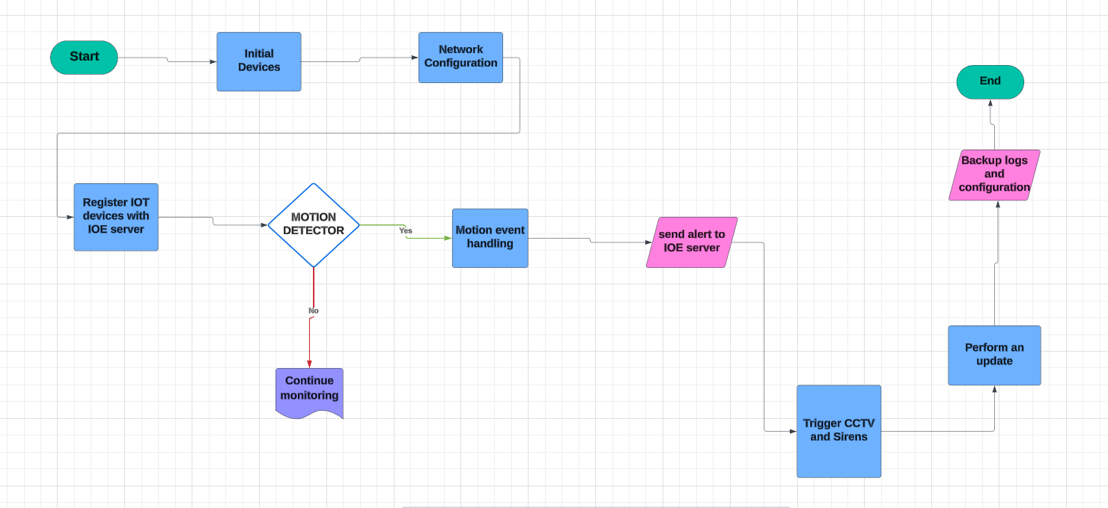
Materials and Methods Used
The Flowchart for motion system

Slide 10
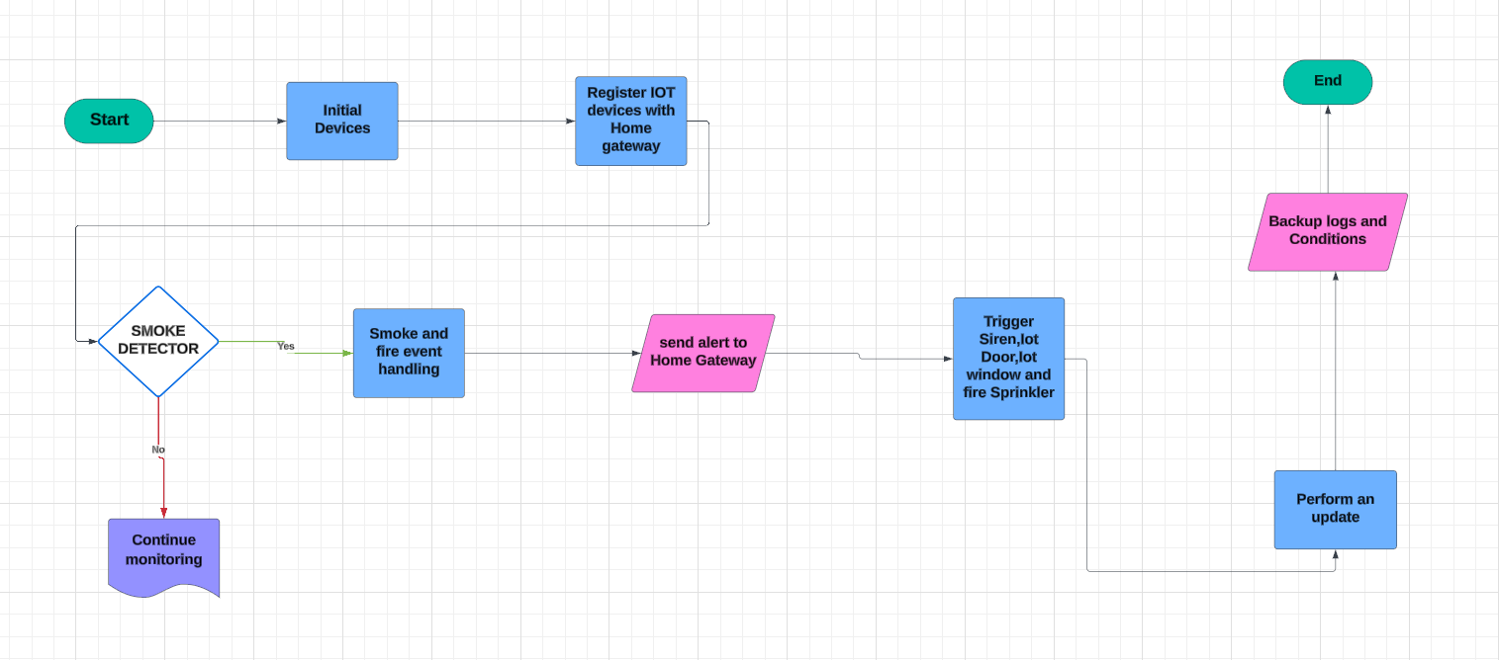
Materials and Methods Used
The flowchart for smoke detection

Slide 11
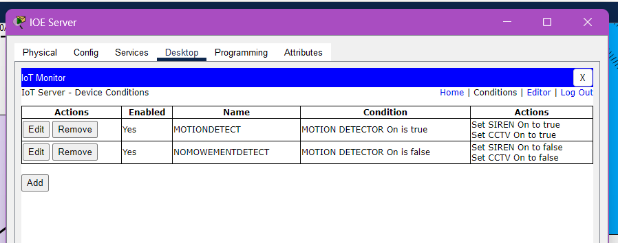
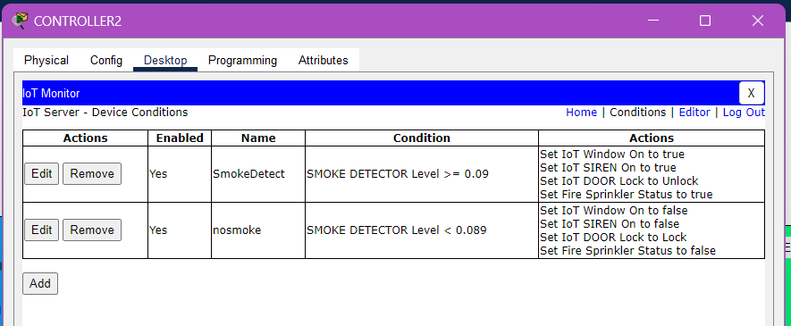
Materials and Methods Used
Conditions for Motion and Smoke Detection

Slide 12
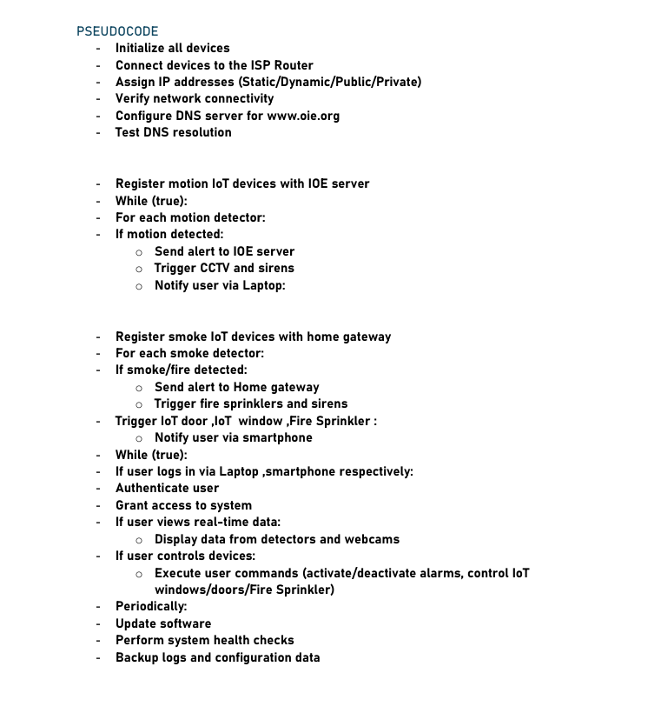
Materials and Methods Used
The Pseudocode for the system

Slide 13
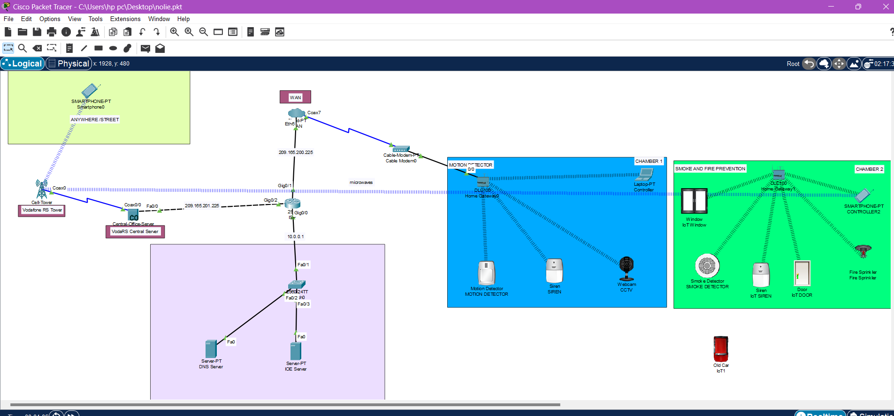
Proposed System
The Proposed System

Slide 14
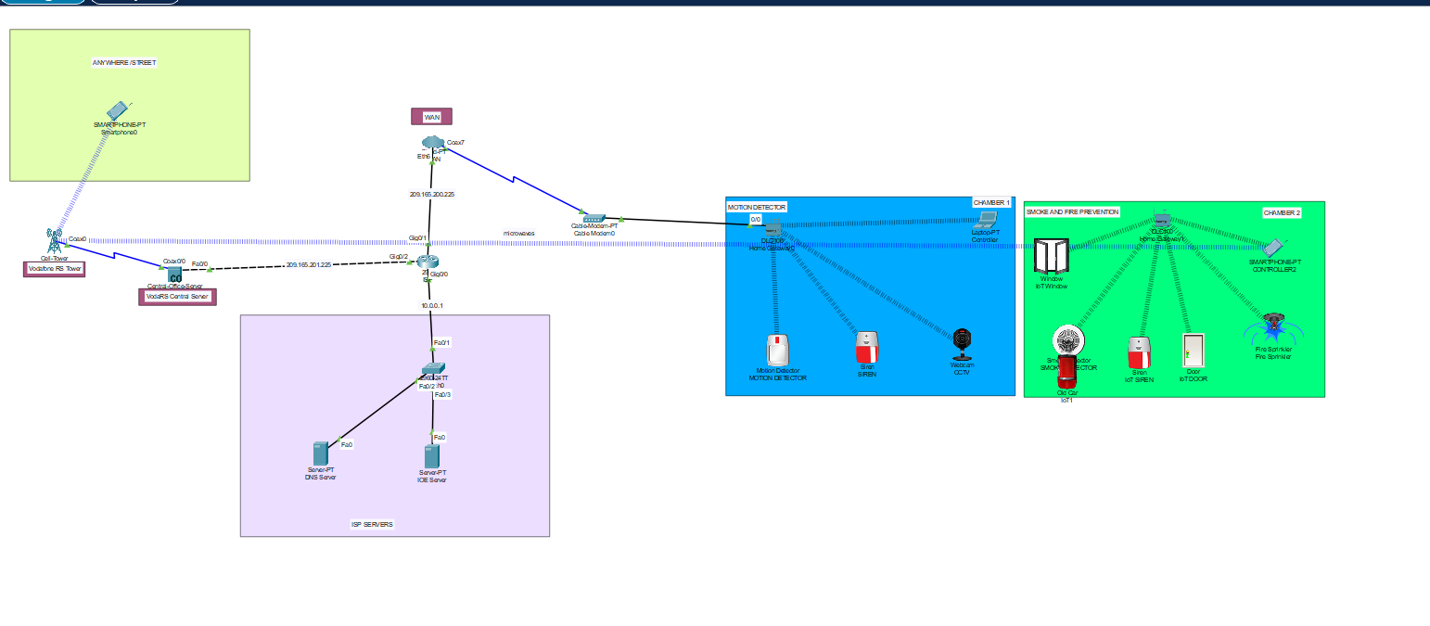
Results and Discussion
The overall Outcome

Slide 15
Results and Discussion

Slide 16
Conclusion(s)
This project successfully integrated IoT-based systems for motion and smoke detection, significantly enhancing security and safety in smart environments. Key components, such as PIR sensors, CCTV cameras, and smoke detectors, were combined with robust communication protocols and cloud storage to create a reliable monitoring system.
Key achievements include:
Accurate Motion Detection: PIR sensors effectively detected movement with minimal false alerts.
Timely Alerts: The system provided real-time notifications and activated alarms promptly, with immediate access to CCTV footage.
Efficient Surveillance: High-quality CCTV video allowed for accurate identification of intruders, supported by remote access.
Seamless Integration: Motion and smoke detection systems were integrated for comprehensive monitoring.
Reliable Communication: Consistent communication between IoT devices ensured stable operation and minimized data loss.
Secure Data Management: Data was securely stored and processed, with protections against unauthorized access.
Efficient Network Operation: The DNS server enabled smooth communication, essential for system performance.

Slide 17
Recommendation(s)
Expansion to More Sensors
AI Integration
User Interface Enhancement
Mobile Application Development
Scalability for Larger Deployments
Energy Efficiency
Security Enhancements
Periodic System Updates

Slide 18
THANK YOU
SUPERVISOR: DR. ALBERT KWANTWI

